Slide 1
M
obile Programming
Term project proposal presentation
Lee Jaeyoon
Oh Seongwon
Lee Sungmin
Lee Subin

Slide 2
TOC
01
Team members information
02
Title & Brief description
03
Contents & Key features
04
Required technologies for implementation
05
Division of task
06
Timeline

Slide 3




Team member
Lee Jae Yoon
Oh Seong won
Lee Sung Min
Lee Su Bin
E-mail :
2jyoons@
naver.com
Student number :
201532749
E-mail :
osw970325@
naver.com
Student number :
201635825
E-mail :
jm970326@
naver.com
Student number :
201635833
E-mail :
eoskan71@
gmail.com
Student number :
201635834

Slide 4
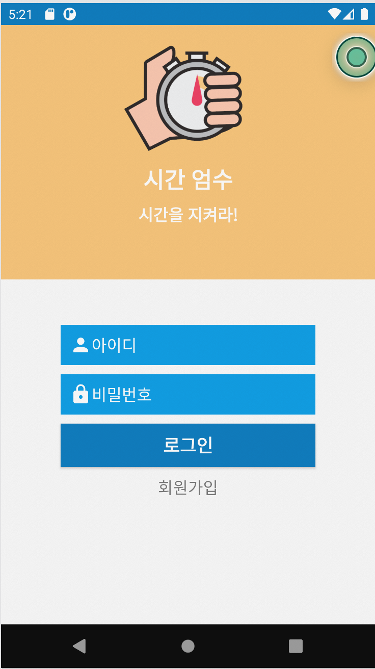
Project Title
Title
시간 엄수
Schedule management application
Brief description
It recommend not only the ability to share schedules among people, but also the time they can use in common
Providing smooth shifts and working environment

Slide 5
Contents
Copy every common functions
in other calendar apps
They can receive which time is empty for every group member to make meeting
If registered schedule, application show specific time which is empty
( ex : meal-time, rest-time, valid call time)
Various function
Easy to set time
Schedule register can set the reading rights for group member or others
Add Contents
Advantage
Set reading right

Slide 6
Key Features
Calendar Sharing
01
Groups can be shared by people with variable working hours, such as police, firefighters, and nurses.
Recommended function
02
Help them organize a meeting by recommending a time that they can use in common.
Selective sharing
03
You can distinguish between private and public schedules.
Alarms and widgets
04
Reminding about schedules through alarm and widget settings.

Slide 7
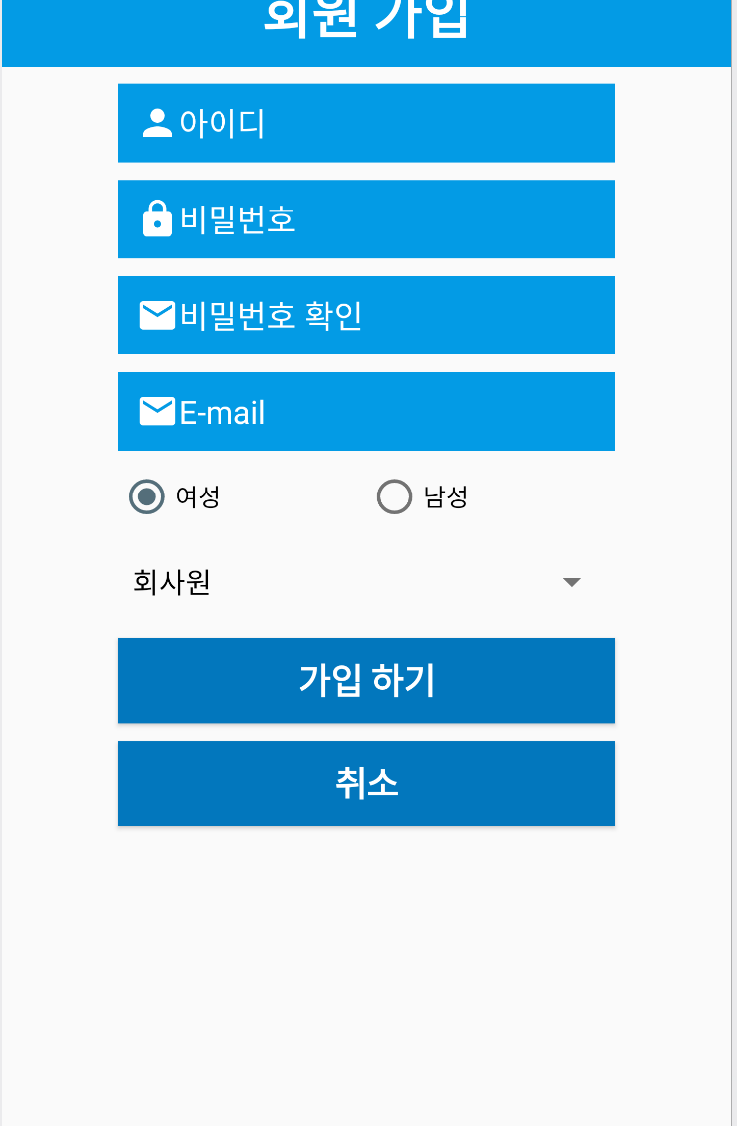
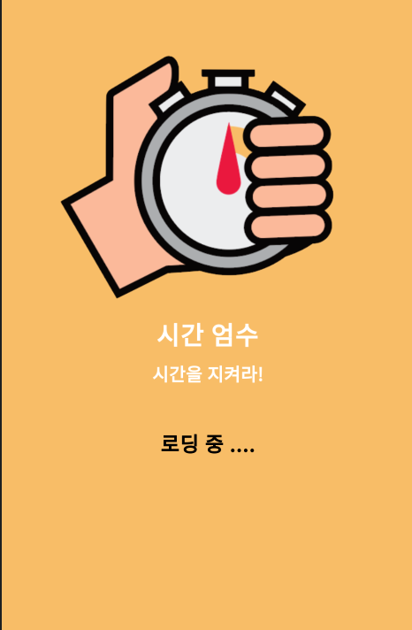
Prototype
Run screen
Join
Login
Screen when first run
Membership window
Enter the schedule management screen

Slide 8
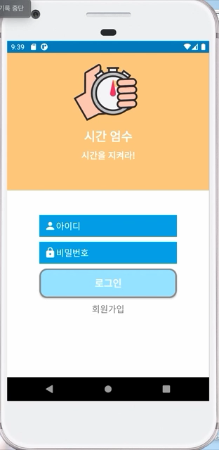
Prototype Examples

Slide 9




Required technologies
Grouping
It is necessary to store data in the form of IDs on the server so that they can be grouped and divided.
Synchronization and fast execution
Identity authentication service
Even when schedule changes are applied, data must be well managed so that time can be recommended in real time.
For security, we must provide own authentication service (e.g. text authentication, email authentication)..

Slide 10
Division of task
Implementation
UI using XML
Make presentation
Implementation
function using Java
Write final report
Implementation
UI using XML
GitHub Management
Implementation
function using Java
Write proposal
Lee Jae Yoon
Oh Seong Won
Lee Sung Min
Lee Su Bin
Notes:
성민 : 로그인, DB
수빈 : group화 커뮤니티 형성
성원 : widget and open API 확인 및 적용
재윤 : UI 디자인 activity 연동 및 서기

Slide 11





Team schedule
~4/24
~5/8
~5/22
~5/31
~6/12
~6/19
6/19
Idea
Adding schedules and adding notes function
Create login and grouping functions
Presentation
Creating a calendar UI using xml
Mid term exam
Project completion and presentation preparation

Slide 12
Thank You

